Slide 1

Adding Hours and Approving Student Timesheet
By Student Employment

Slide 2
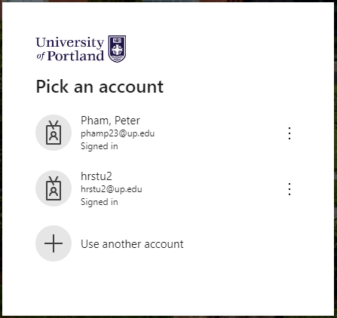
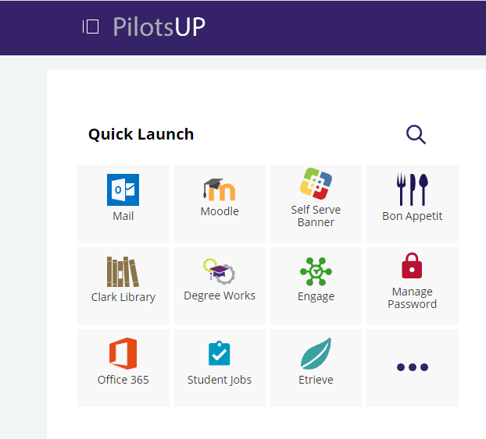
Step 1: Log Into Self Serve Banner
Access Self Serve Banner at pilots.up.edu.
Log-in with student username and password.

Slide 3
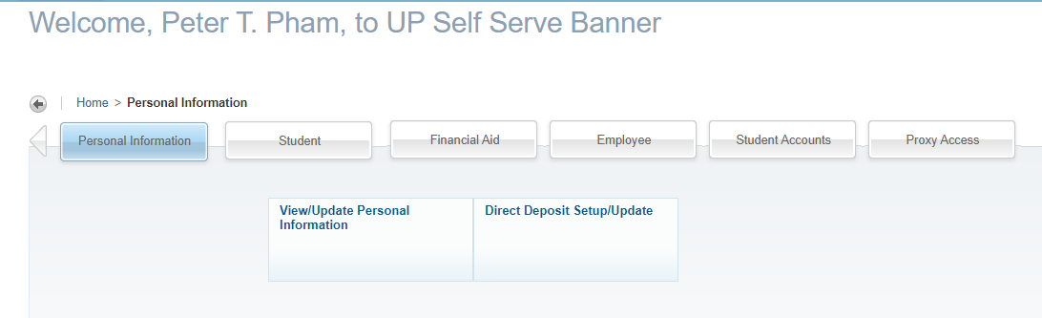
Step 2: Navigate to the Employee Dashboard
Click “Employee” on Self Serve to go to the Employee Dashboard.

Slide 4
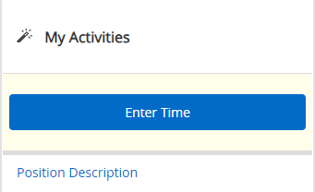
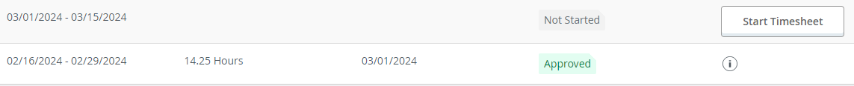
Step 3: Start a Timesheet
When in the Employee Dashboard, click “Enter Time”.
Click “Start Timesheet” of the appropriate work week to get into the timesheet.
When you’ve started the timesheet for the week, it will then say, “In Progress”.

Slide 5
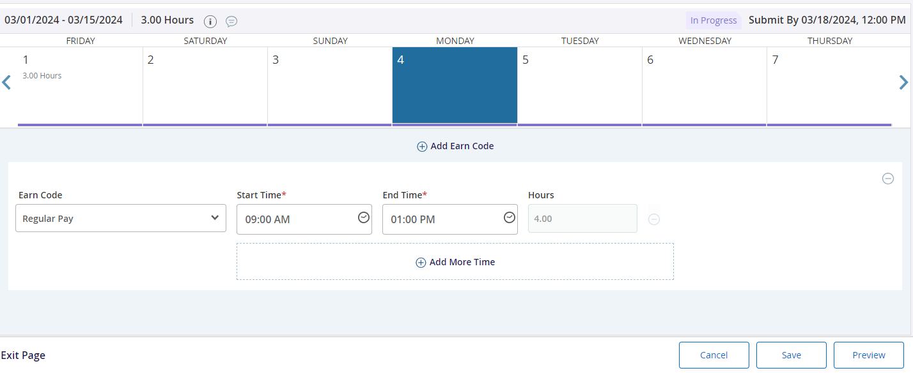
Step 4: Add Hours to Timesheet
Click on the date that you want to add hours to.
The calendar box should be highlighted in blue.
Add start and end times.
Times must be input as XX:XX AM/PM.
Ex: 08:30 AM, 12:30 PM, 06:00 AM, 08:00 PM.
Click “Save” to save the entry.
Note: if multiple shifts were completed on the same day OR a lunch break was taken, click “Add More Time” to repeat the process.
See Step 5 for more details on lunch breaks.

Slide 6
Step 4 (con): Timesheet View
1
2
3

Slide 7
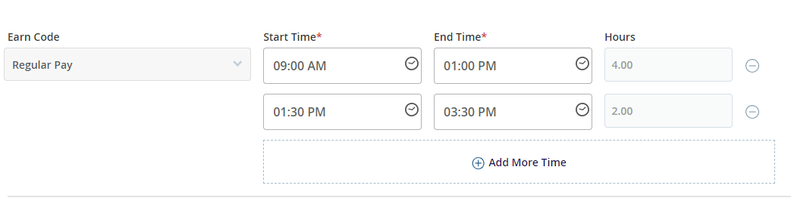
Step 5: Lunch Breaks
If students are working 6 hours or more, an unpaid 30-min lunch break is required.
Example Scenrio:
Peter is working a 6-hour shift (9 AM – 3:30 PM) and will take an unpaid lunch break at 1 PM. His timesheet will look like the following:

Slide 8
Step 6: Approving Timesheet
After submitting ALL times for your schedule:
Click on the timesheet.
Click "Preview" on the bottom-right corner of the page.
Review all times in "Time Entry Detail".
Click "Return" if times are incorrect and changes need to be made.
Click "Submit" if all time entries are correct for the week.
"Timesheet successfully submitted" will appear on the top-right corner.
See next slides for figures.

Slide 9
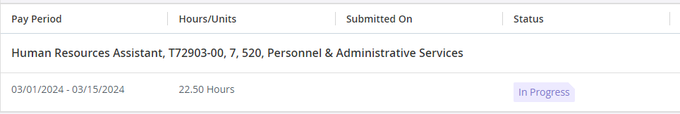

Step 6 (con): Approving Timesheet

Slide 10
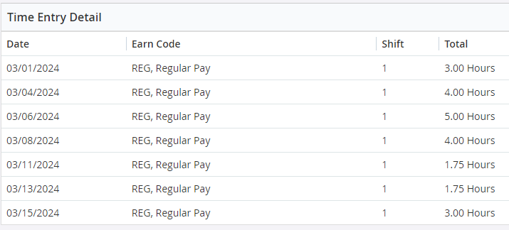


Step 6 (con): Approving Timesheet

Slide 11
Contact Information
Student Employment
Studentemployment@up.edu
Waldschmidt 110
Payroll
Payroll@up.edu
Waldschmidt 501

